Slide 1
IB History of the Americas
A brief overview

Slide 2
Course Outline
The following slides are really brief outlines of the History of Americas course. Note that these are not all of the topics covered and this only pertains to History of the Americas 1.

Slide 3
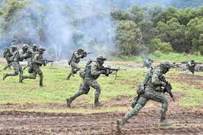
The Wars
The main wars that you will cover are:
*The Civil War (1861-1865); the federal union and southern states fought to secede and form the Confederacy.
*World War I (1914-1918): Axis Powers vs Central Powers
*World War II (Cold War) (1939-1945): Soviets wanted communism, America wanted democracy
*Iran-Contra Affair
These will be covered extensively in class, this is just a brief overview.

Slide 4
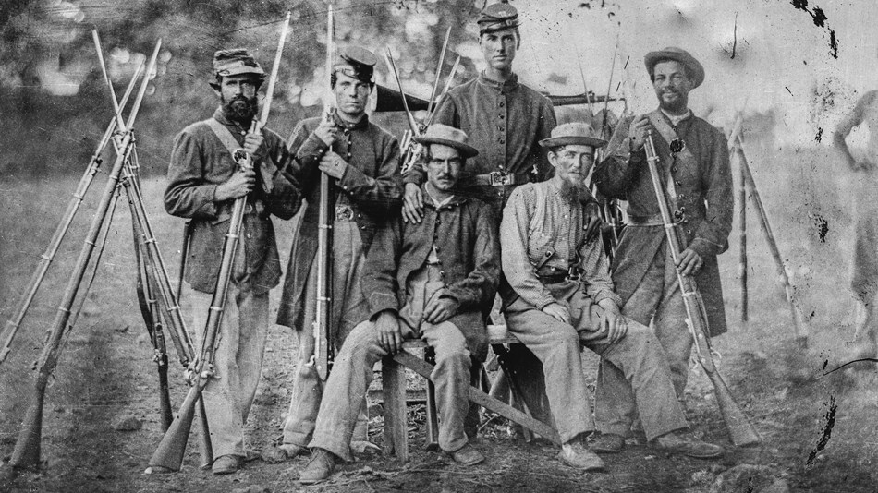
The Civil War
Focus on the cause of the civil war and how it affected early America.

Slide 5
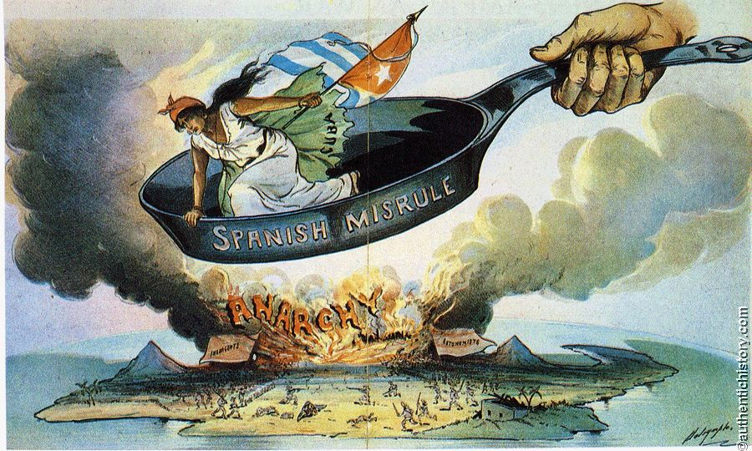
The Spanish-American War
How did the United States perceive Latin America?
The major battle occurred in Main

Slide 6
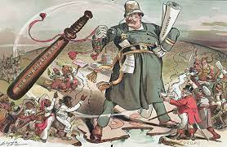
The Big Stick Policy
President Theodore Roosevelt
America occupying Venezuela, Mexico, Santo Domingo, Cuba, and Panama

Slide 7
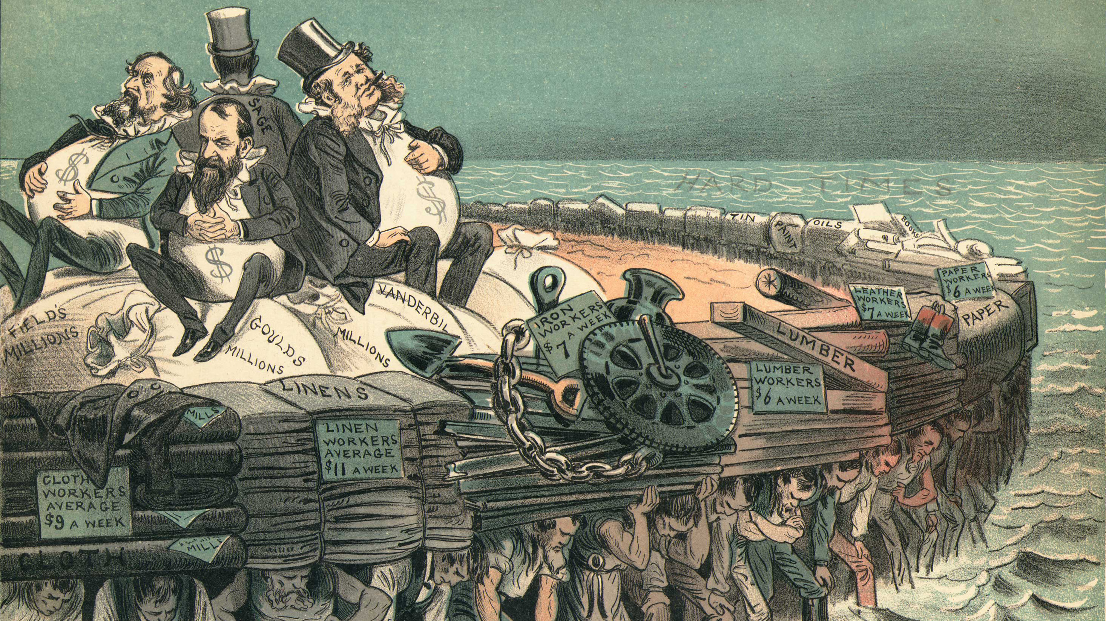
The Gilded Age
Expansion and industrialization of the United States
The 3 robber barons: Andrew Carnegie, John D. Rockefeller, and JP Morgan Chase

Slide 8
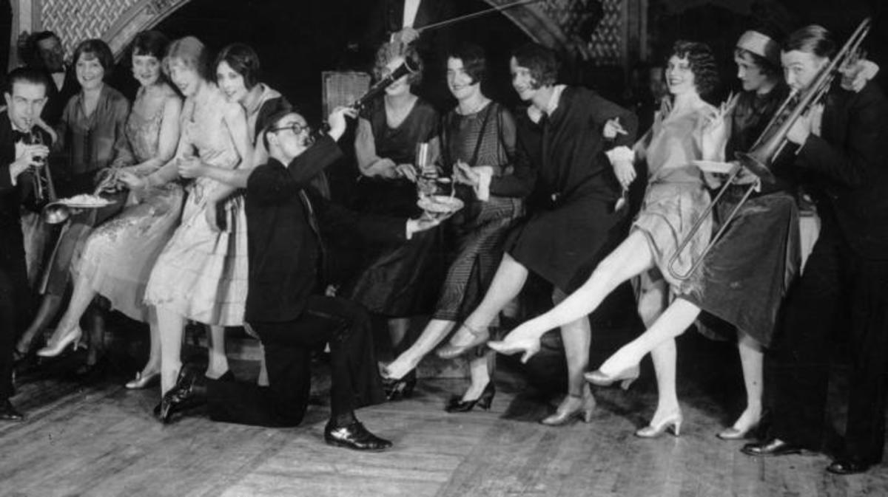
The Roarin’ 20s
Flappers
Credit systems
The Great Depression
Social and political movements

Slide 9
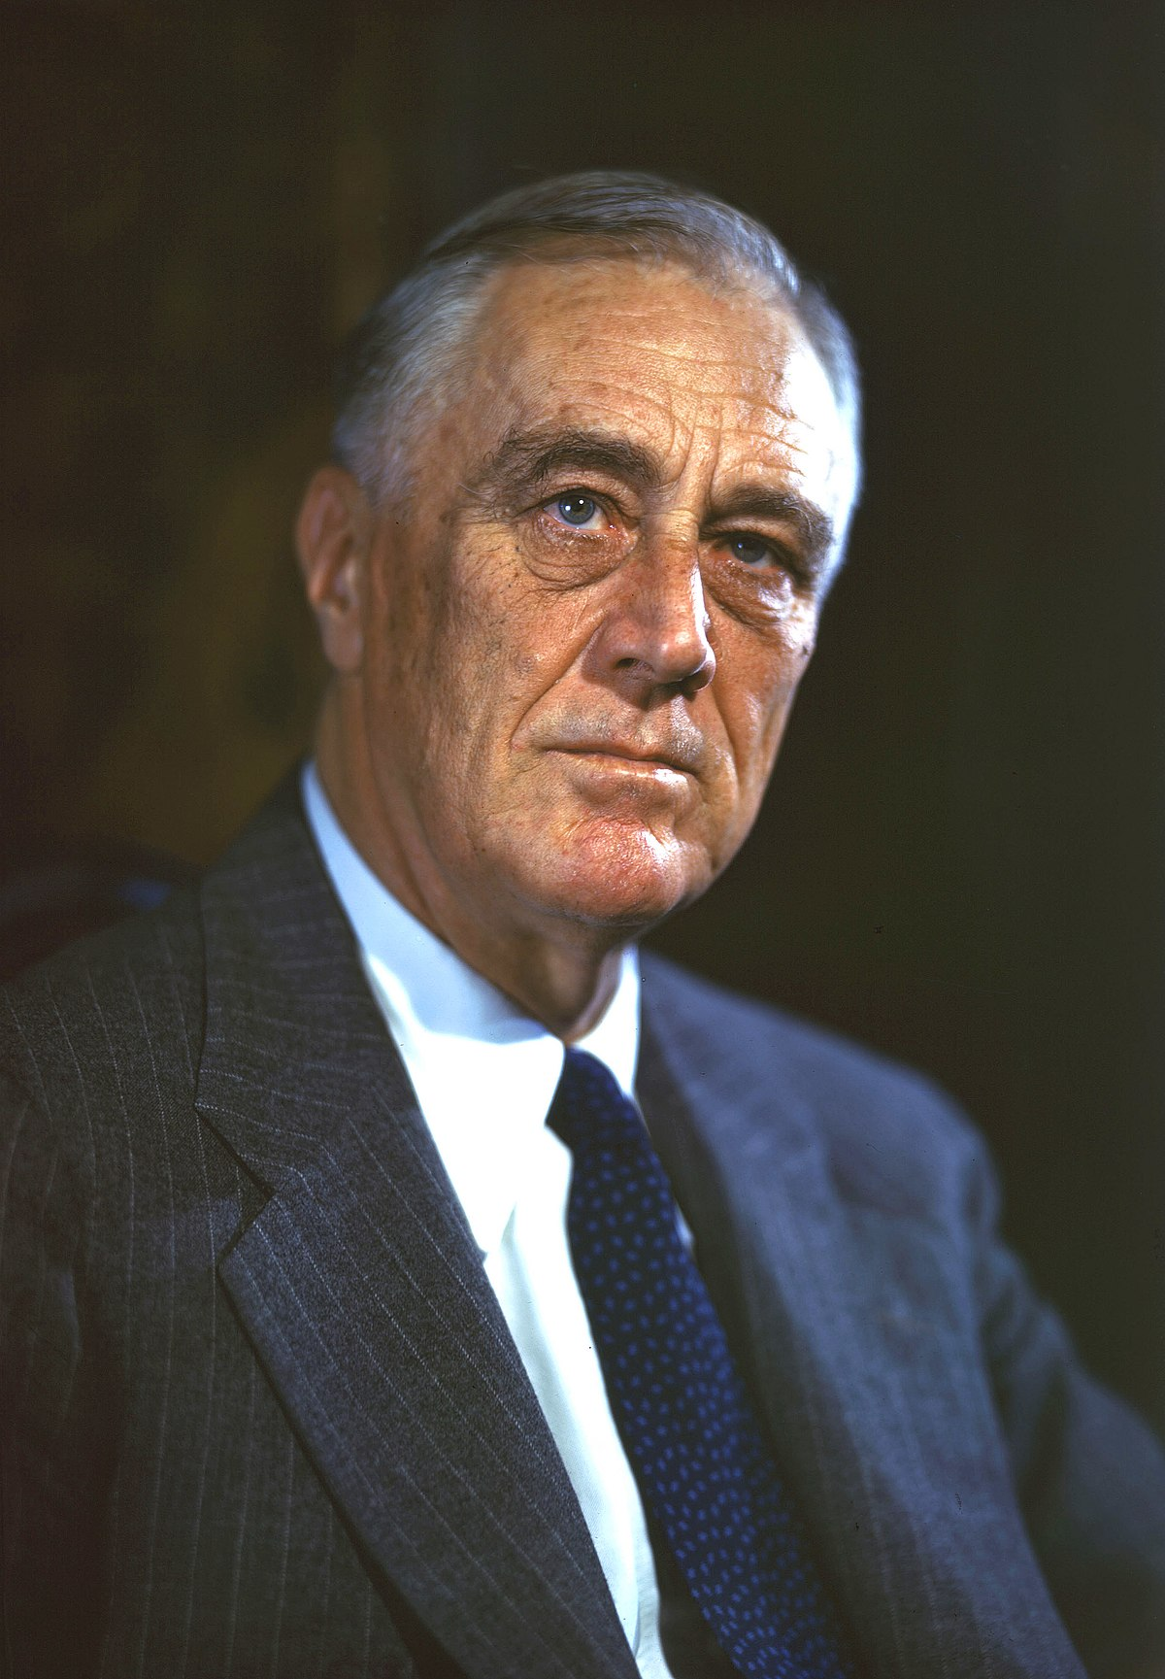
America vs Everybody
Franklin D. Roosevelt
Lazaro Cardenas and the Oil Expropriation
The Civil Rights Movement

Slide 10
The 70s and 80s
Nixon and the Watergate scandal
Pinochet’s reign in Chile
Jimmy Carter and the “Crisis of Confidence”
Ronald Reagan and “Reagonomics”
Bill Clinton

